Slide 1

Term II ML Project
Analysing Air Quality

Slide 2
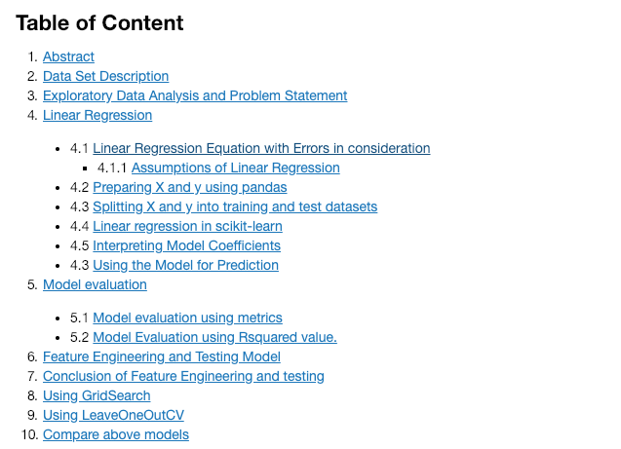
Air Quality DataSet

Slide 3
Data Set Information
The Dataset has been picked up from # https://archive.ics.uci.edu/ml/datasets/Air+quality#
The dataset contains 9358 instances of hourly averaged responses from an array of 5 metal oxide chemical sensors embedded in an Air Quality Chemical Multi-sensor Device.
The device was located on the field in a significantly polluted area, at road level ,within an Italian city. Data were recorded from March 2004 to February 2005 (one year)representing the longest freely available recordings off on field deployed air quality chemical sensor devices responses.
Ground Truth hourly averaged concentrations for CO, Non Metalic Hydrocarbons, Benzene, Total Nitrogen Oxides (NOx) and Nitrogen Dioxide (NO2) and were provided by a co-located reference certified analyser.

Slide 4
Problem Statement & EDA
Predict the Relative Humidity of a given point of time based on the all other attributes affecting the change in RH.

Slide 5
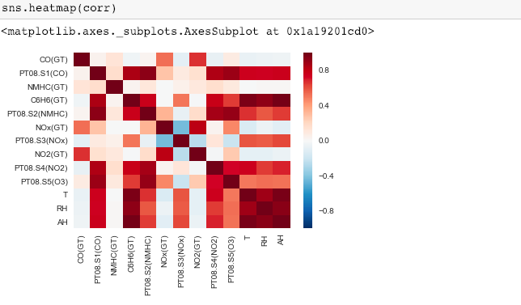
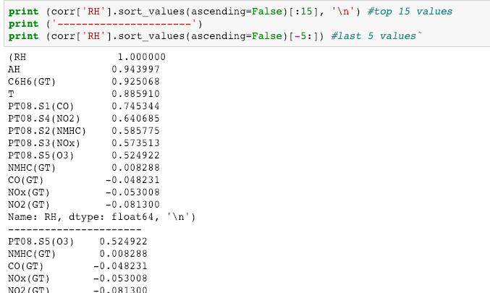
Analysing Correlation
C6H6(GT) and T are highly correlated with Relative Humidity

Slide 6
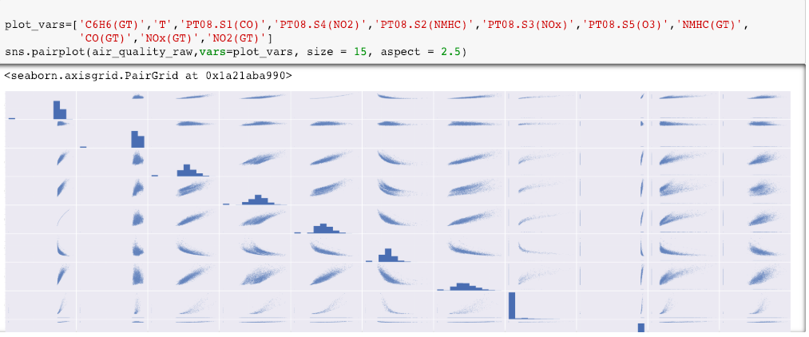
Plotting joint and pair plot for correlated variables

Slide 7
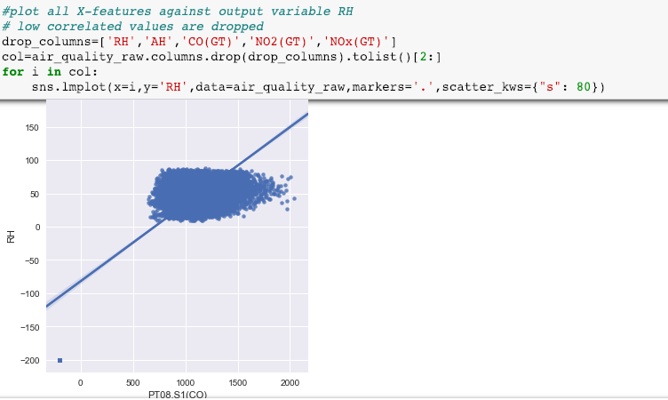
Plotting predictor variables against RH

Slide 8
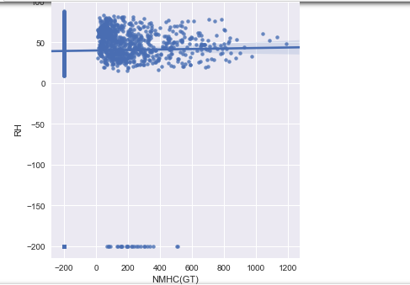
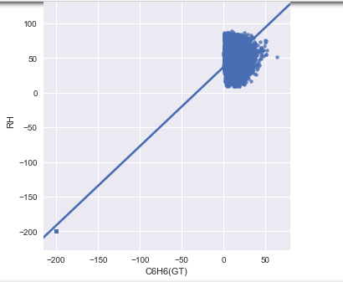
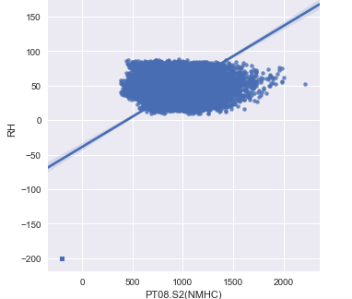
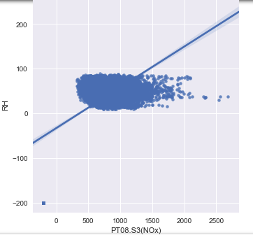

Slide 9
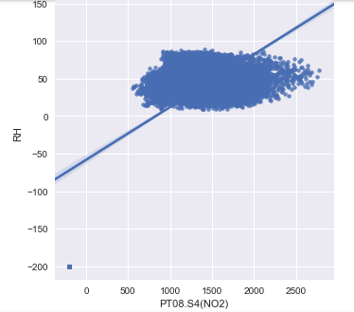
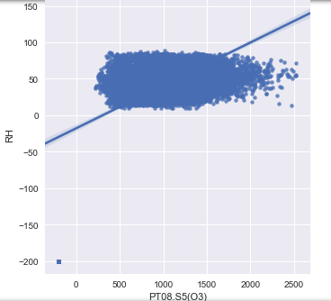
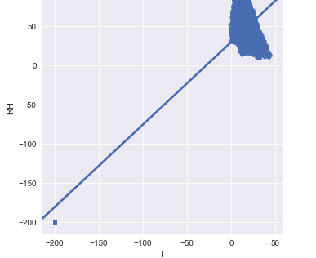

Slide 10
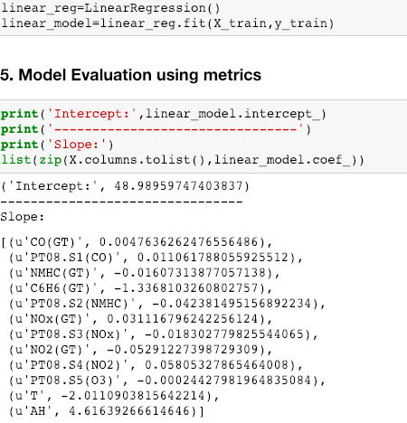
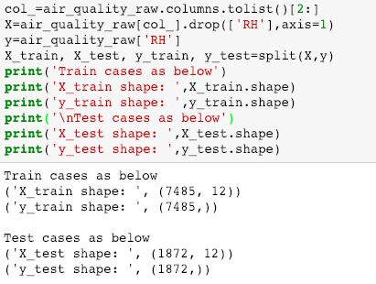
Linear Regression
The data has been split into train and test set and linear Regression model was called to get the intercept and slope values for corresponding predictors. Error terms were calculated to get the difference between predicted and actual value.

Slide 11
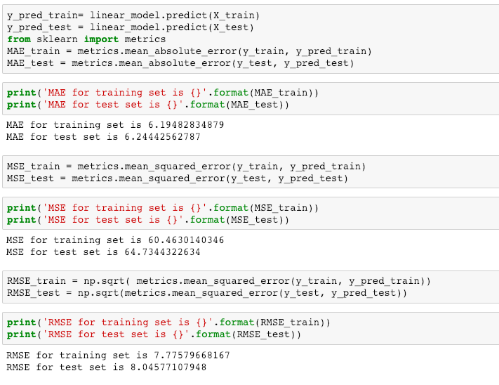
It is found that baseline model has higher RMSE /MAE/MSE for test set than training set .

Slide 12
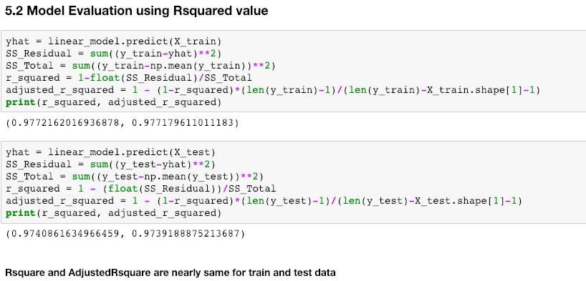

Slide 13
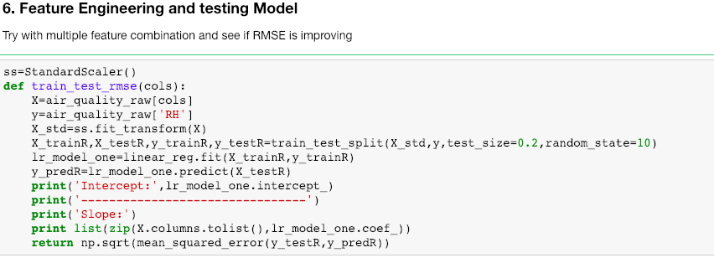
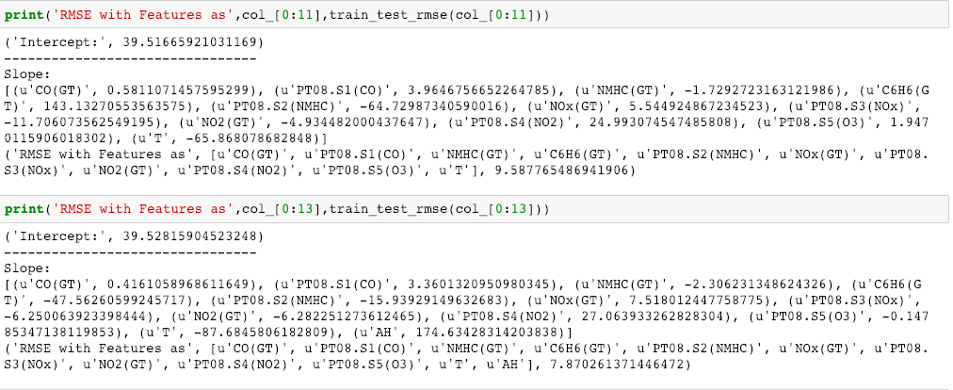
Can we do something better ??
RMSE has improved a bit when all the columns were considered and linearRegression was run with Standard Scalar fit and transform .

Slide 14
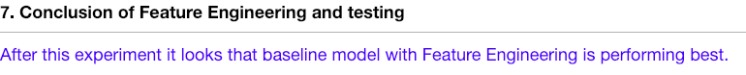
Can we still do something more to improve the result ??
Let’s perform gridSearchCV and LeaveOneOut CV and compare all the results

Slide 15
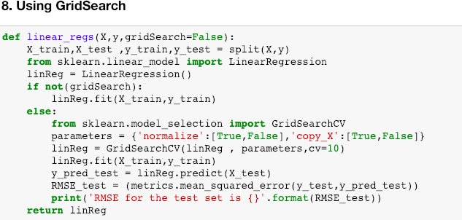
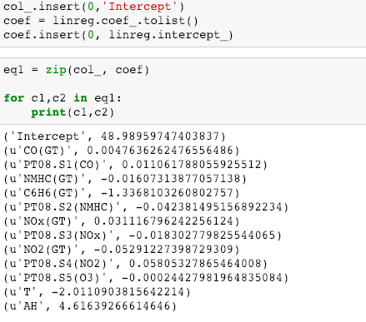

Slide 16
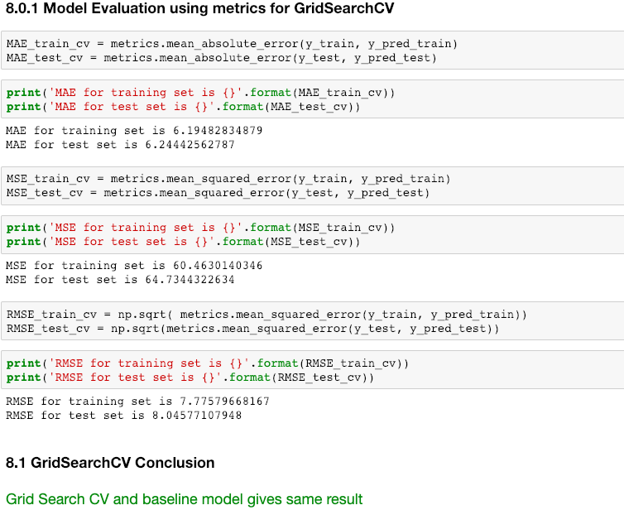
Since GridSearchCV and baseline model are still same lets try out with LeaveOnceOut CV and see it it improves the result

Slide 17
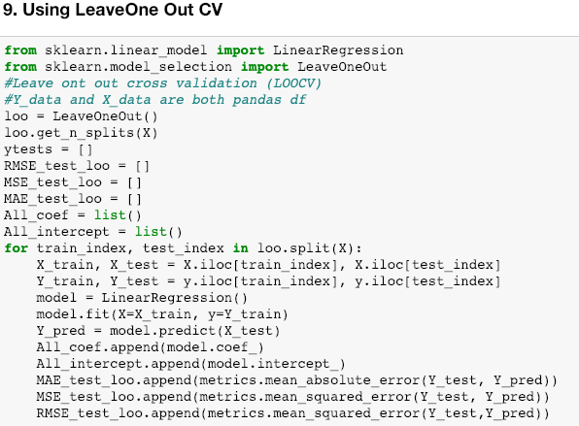
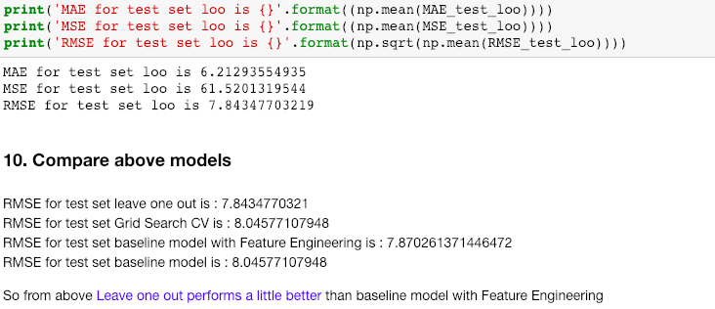

Slide 18
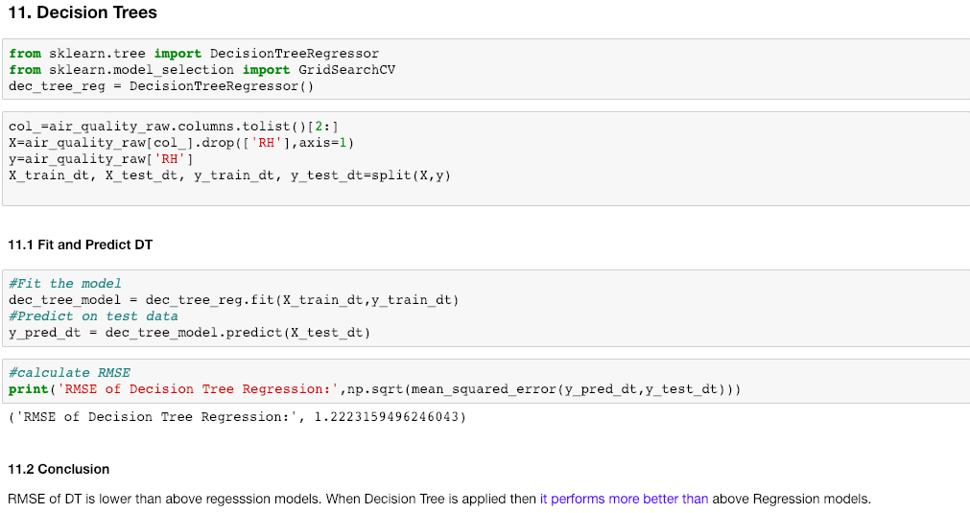
Performing Decision Trees and Random Forest on above data set and find the result

Slide 19
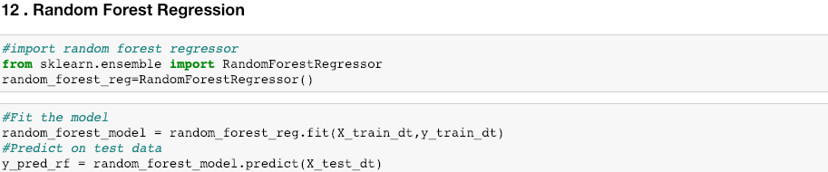
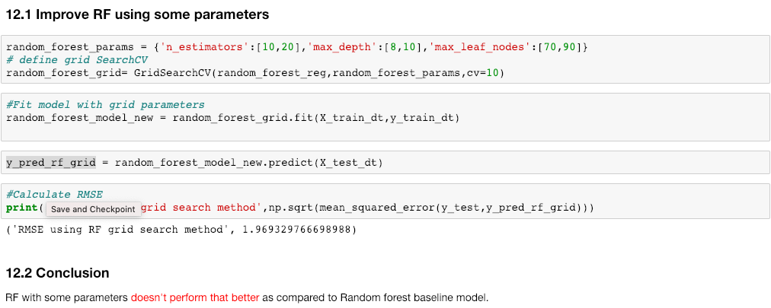
Using Random Forest with Parameters

